Slide 1
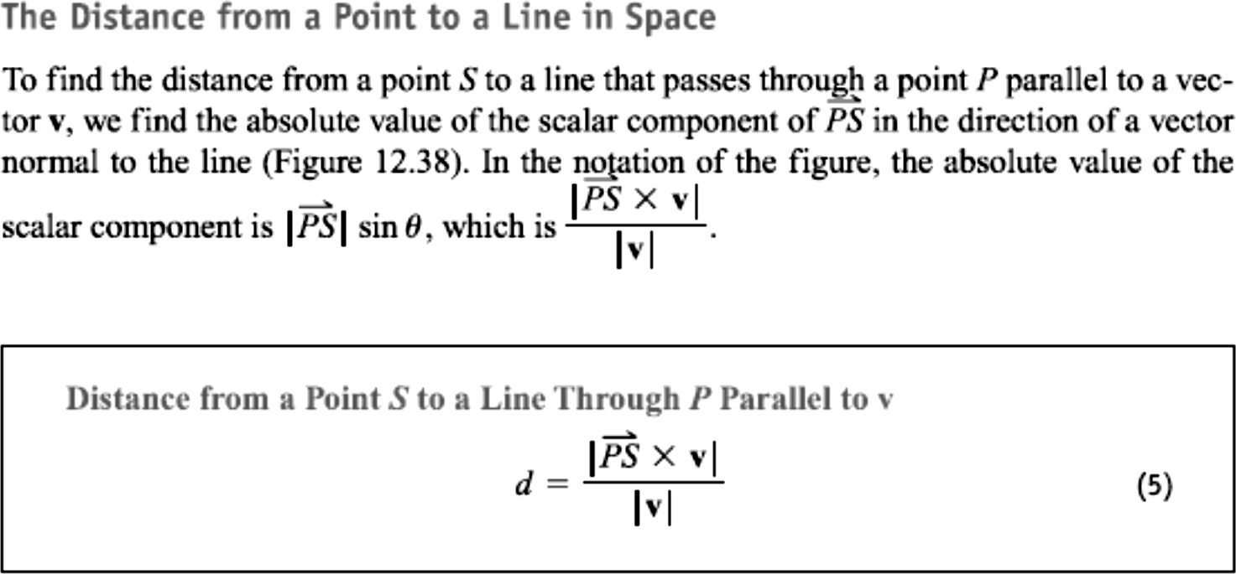
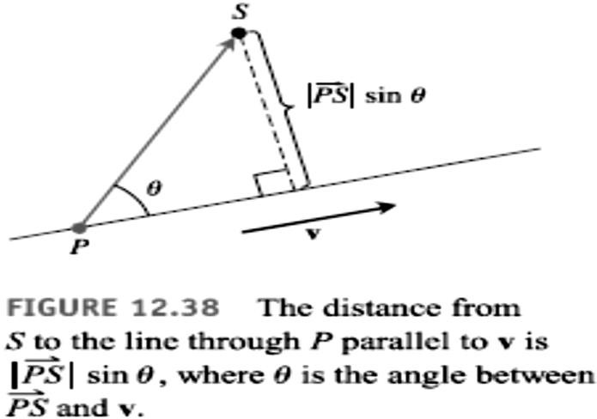
20 / Dep. Of Engineering Mechanics
Class: 2th AMTHMATICS / The vector

Slide 2
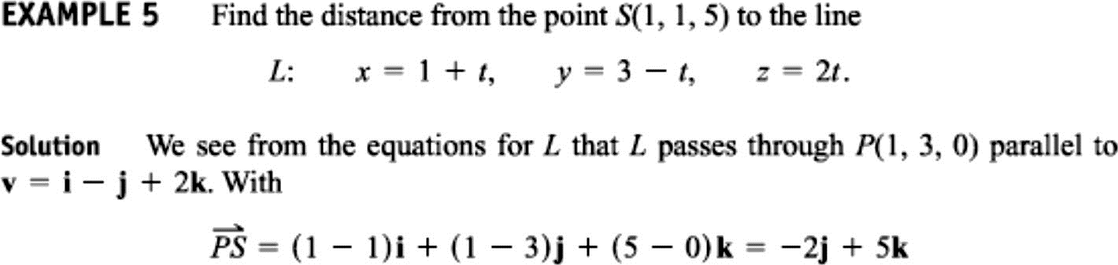
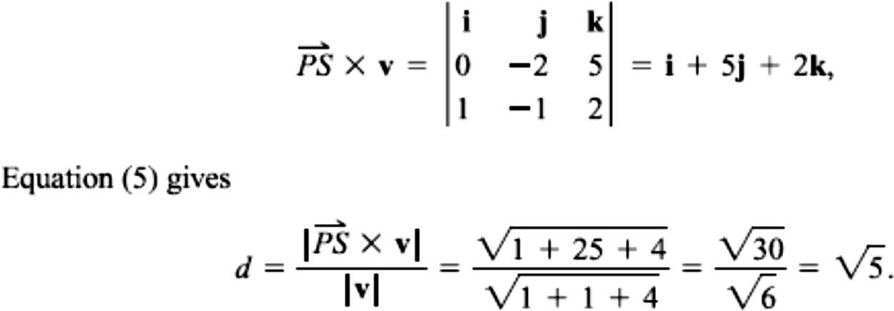

Slide 3
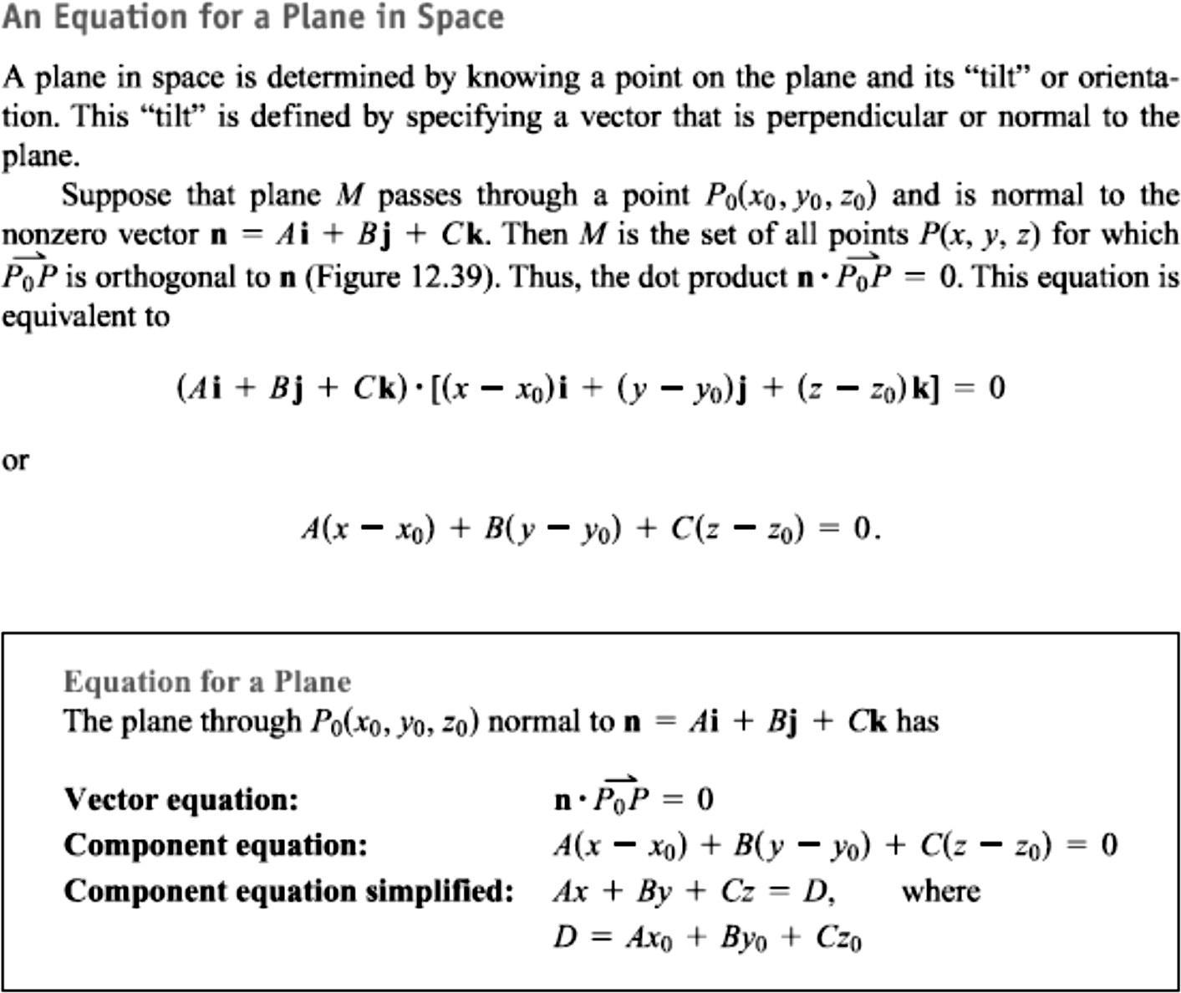
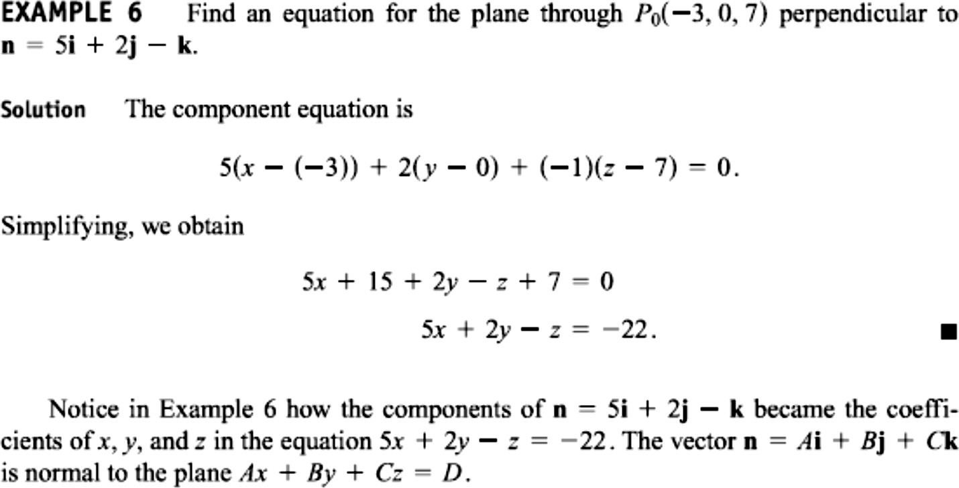
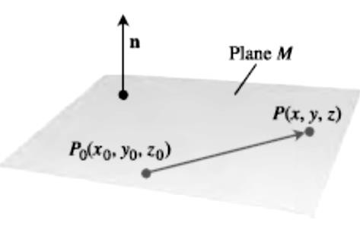
21 / Dep. Of Engineering Mechanics
Class: 2th AMTHMATICS / The vector

Slide 4
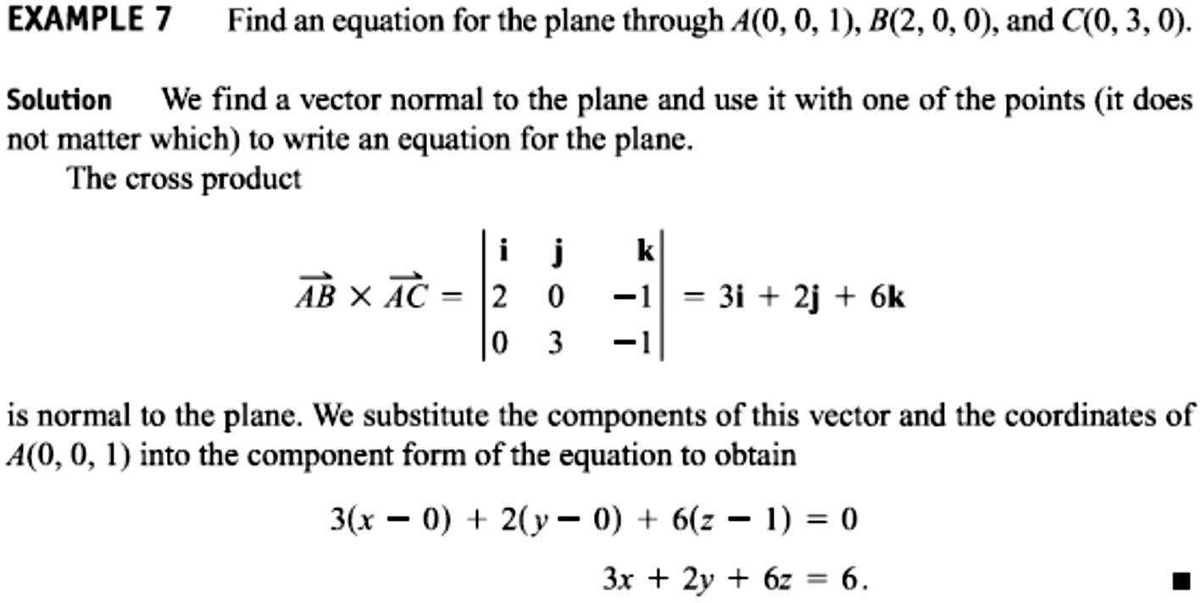
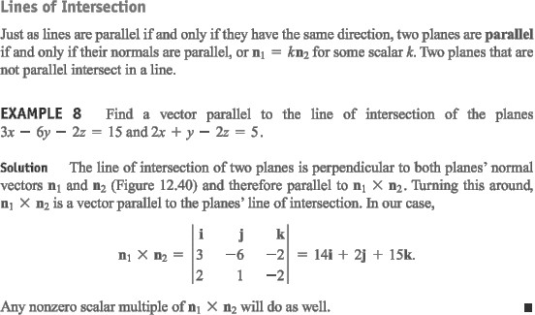
22 / Dep. Of Engineering Mechanics
Class: 2th AMTHMATICS / The vector

Slide 5
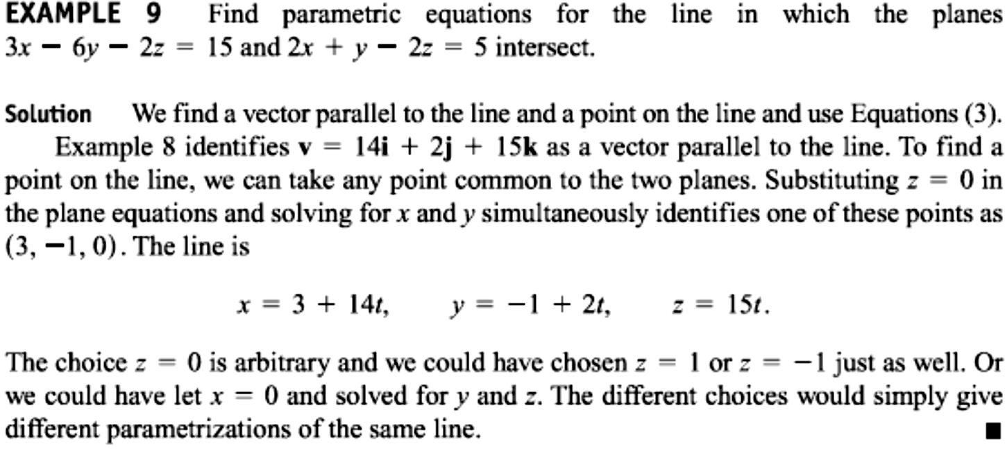
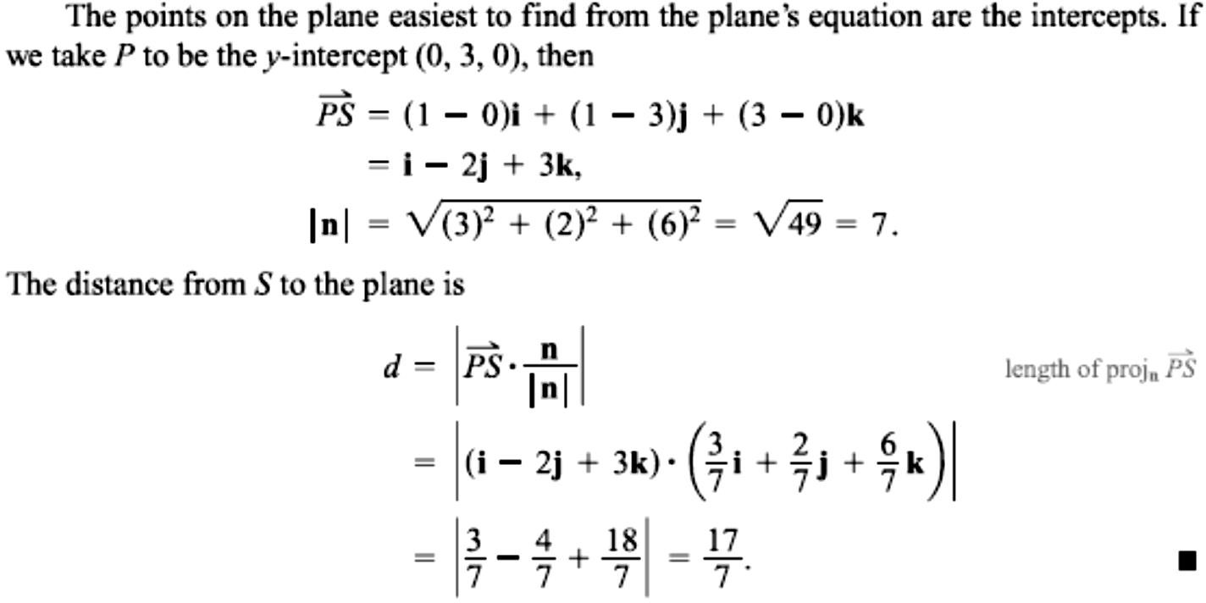
23 / Dep. Of Engineering Mechanics
Class: 2th AMTHMATICS / The vector

Slide 6
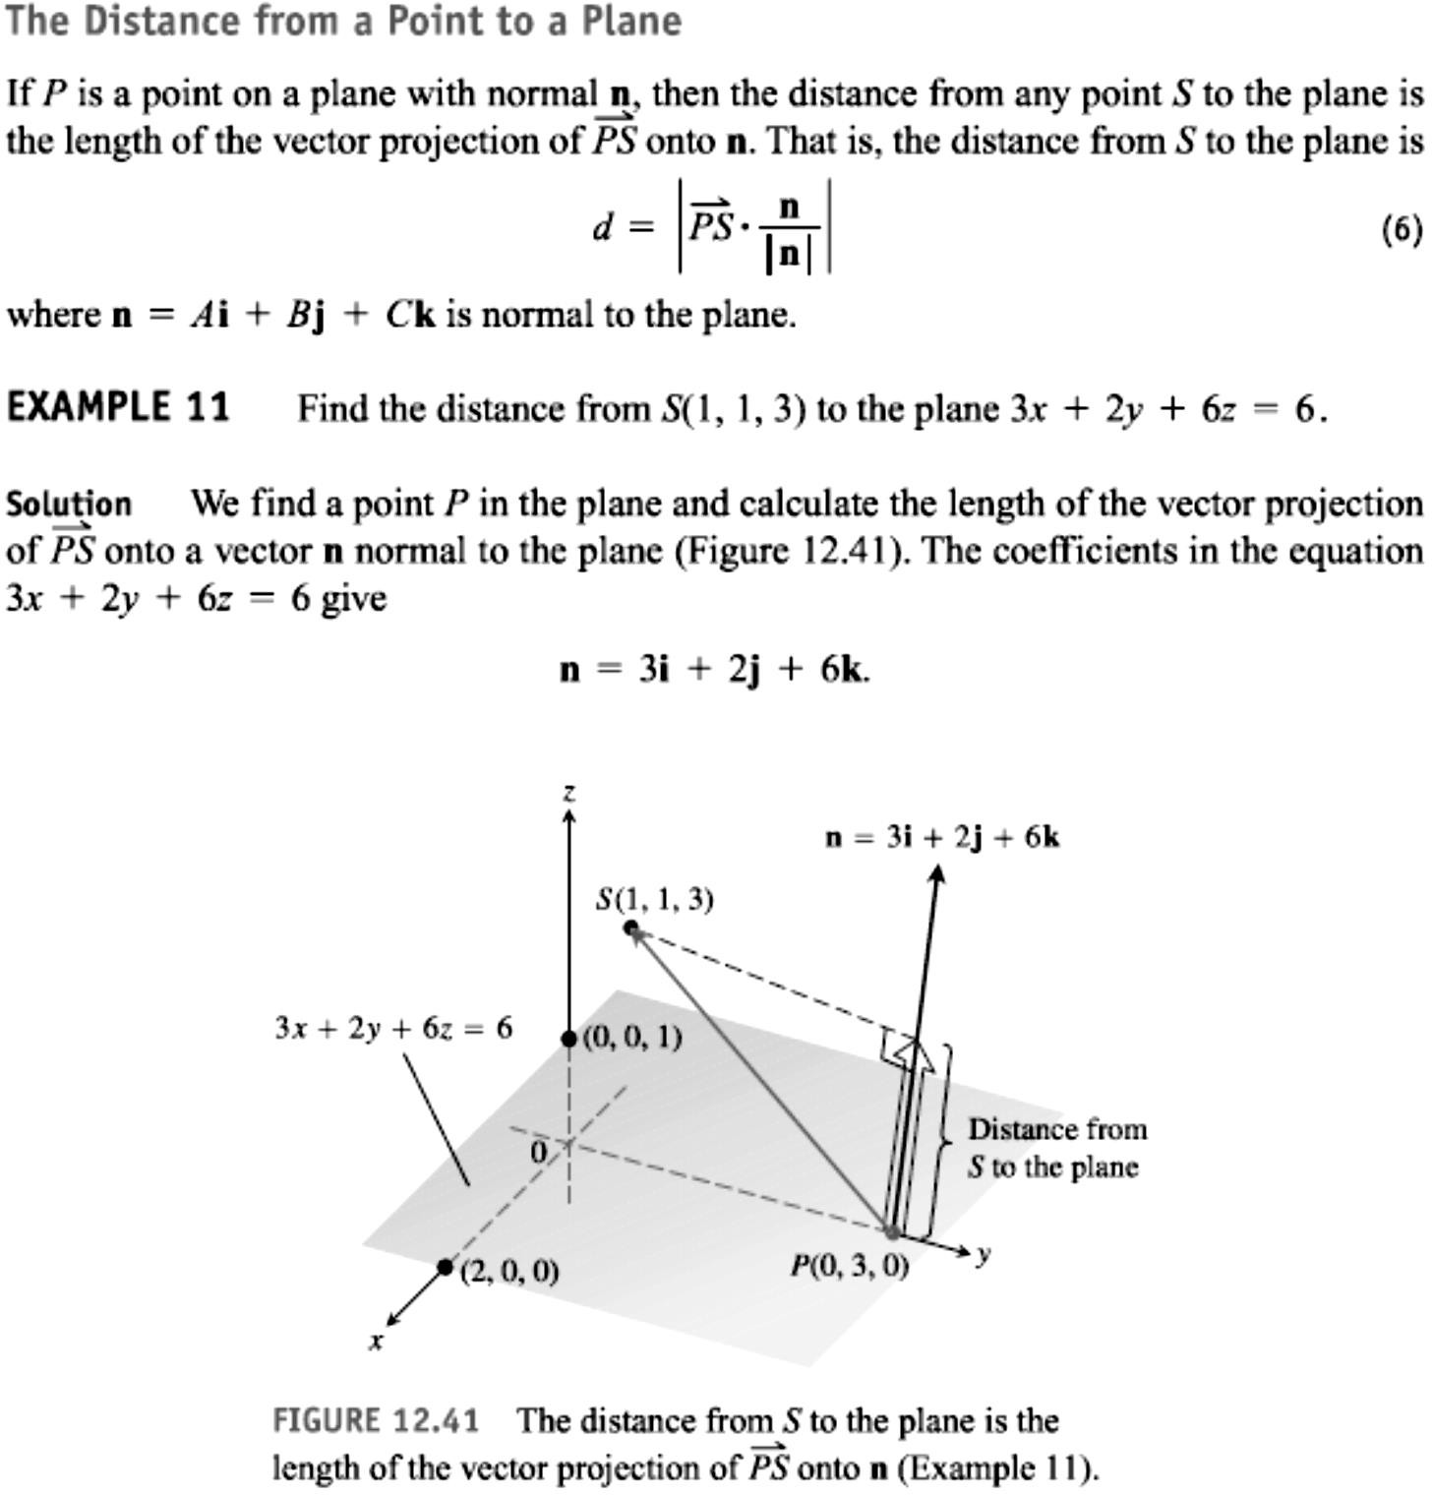
24 / Dep. Of Engineering Mechanics
Class: 2th AMTHMATICS / The vector

Slide 7
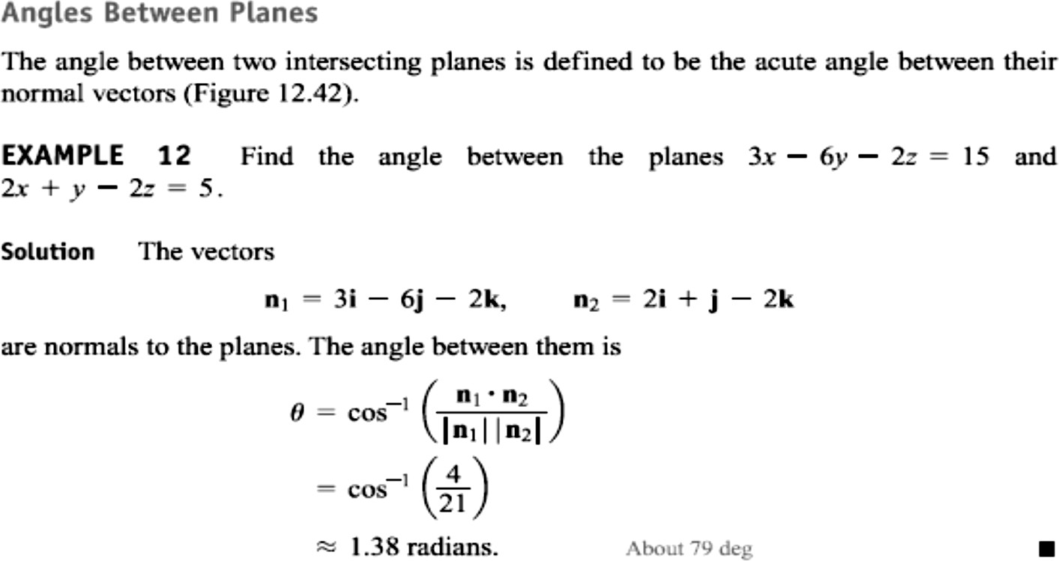
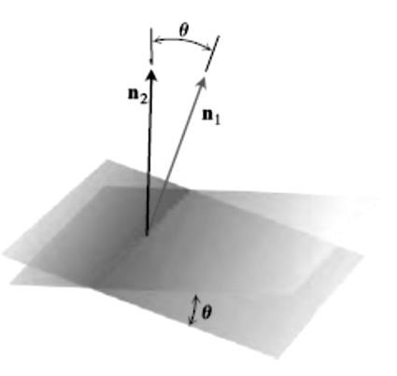
25 / Dep. Of Engineering Mechanics
Class: 2th AMTHMATICS / The vector

